Slide 1
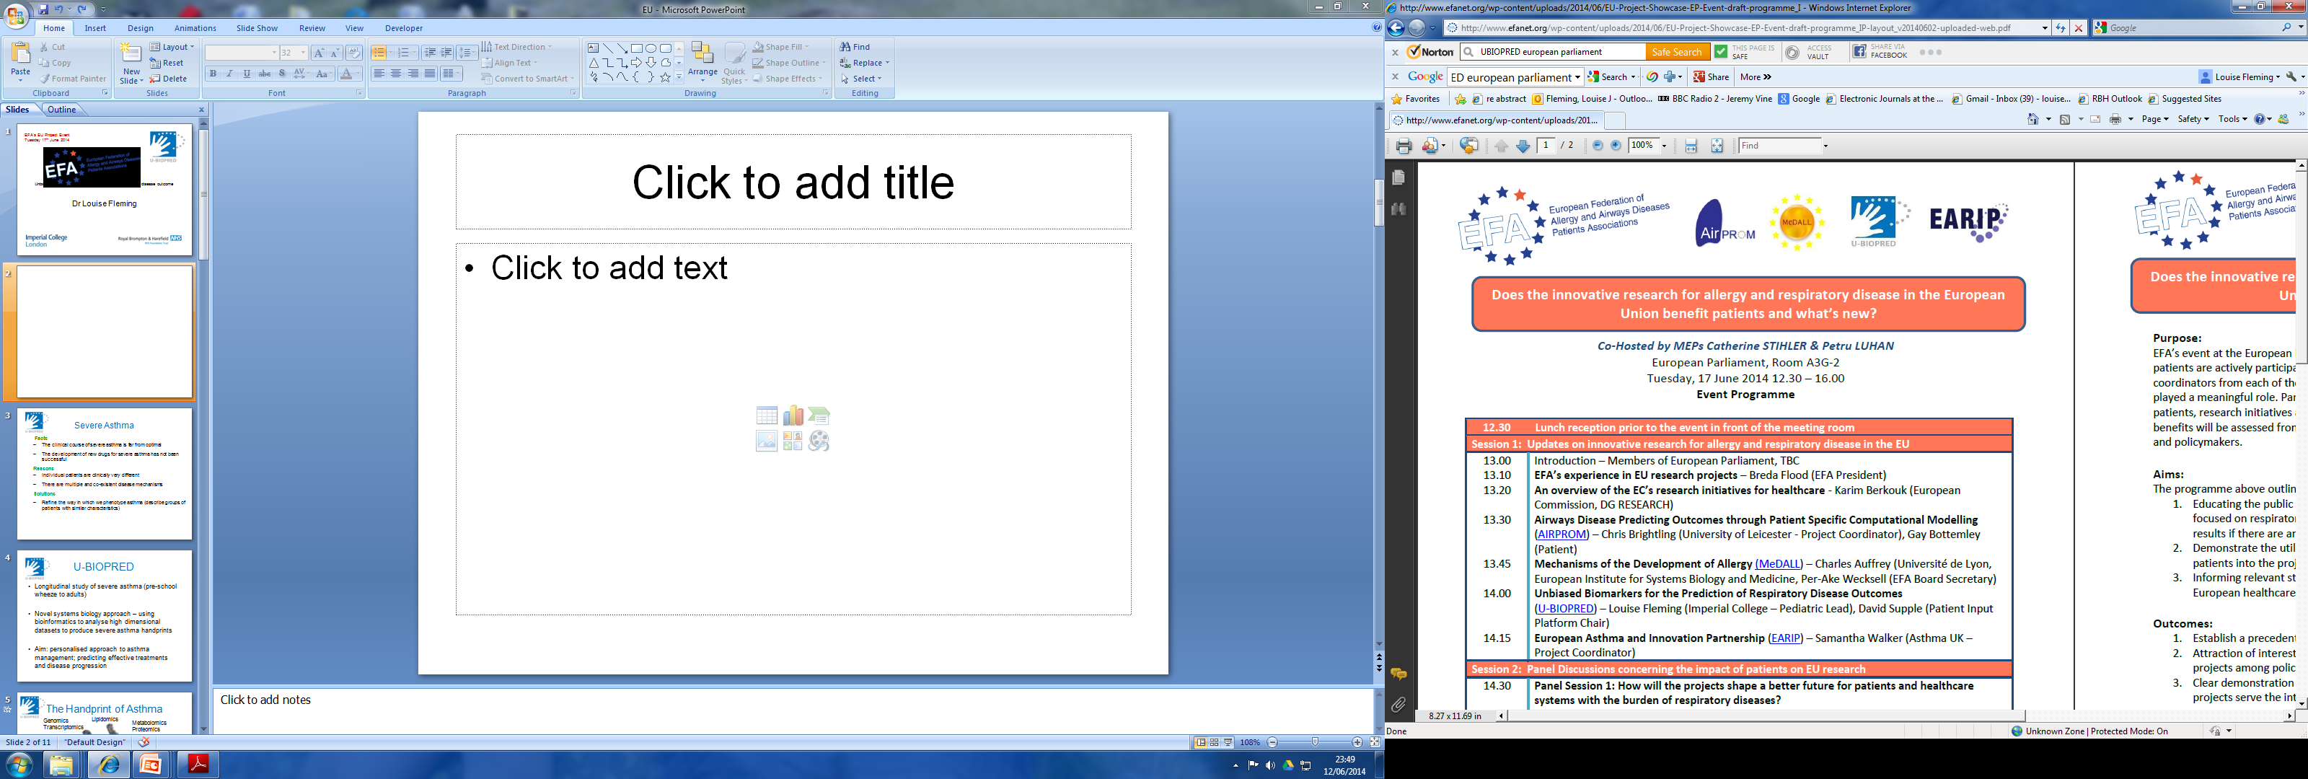

U-BIOPRED
Unbiased BIOmarkers for the PREDiction of respiratory disease outcome
Dr Louise Fleming

Slide 2
Severe Asthma
Facts
  The clinical course of severe asthma is far from optimal
  The development of new drugs for severe asthma has not been successful
  Reasons
  Individual patients are clinically very different
  There are multiple and co-existent disease mechanisms
  Solutions
  Refine the way in which we phenotype asthma (describe groups of patients with similar characteristics)

Slide 3
U-BIOPRED
Longitudinal study of severe asthma (pre-school wheeze to adults)
Novel systems biology approach – using bioinformatics to analyse high dimensional datasets to produce severe asthma handprints
Aim: personalised approach to asthma management; predicting effective treatments and disease progression

Slide 4
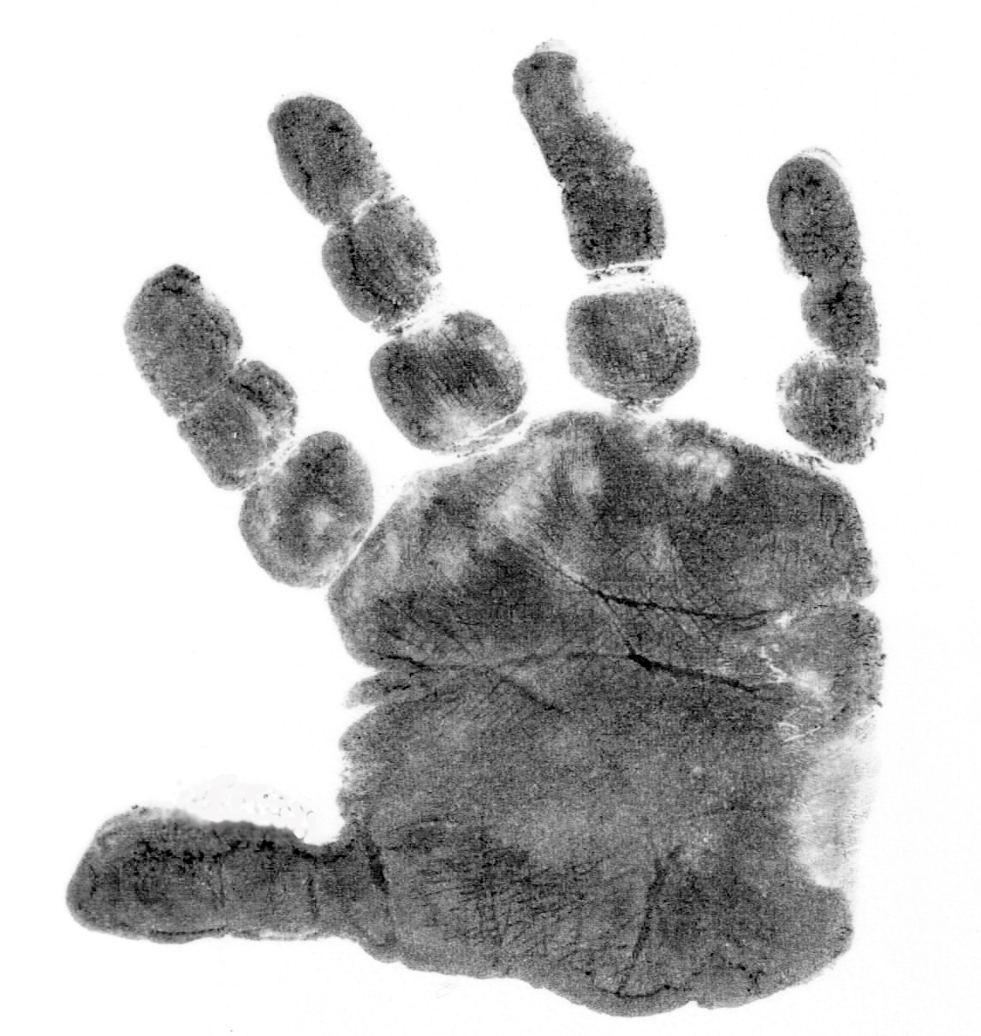
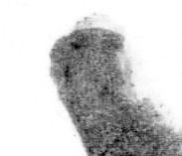
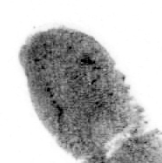
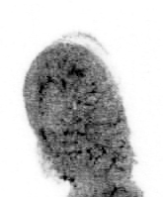
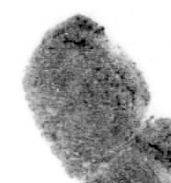
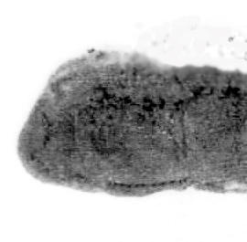
“Handprint” of Asthma
Genomics
Transcriptomics
Lipidomics
Metabolomics
Proteomics
Inflammometry
Patient reported
outcomes
Combining multiple high dimensional datasets
Clinical

Slide 5


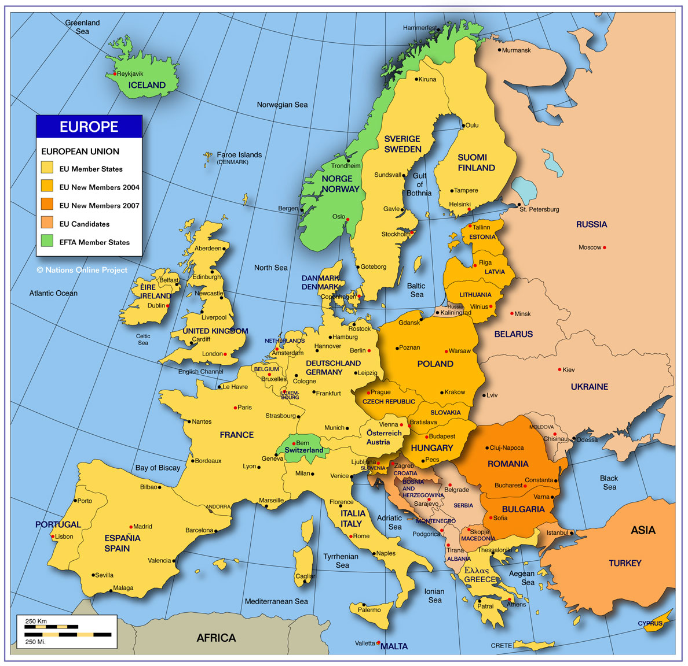
20 Academic institutions
6 Patient organisations
9 Biopharma companies
3 Small and medium sized enterprises
Clinical centres
16 adult centres
7 paediatric centres
United Kingdom (4)
Netherlands (1)
Germany (1)
Switzerland (1)
France (1)
Italy (2)
Hungary (1)
Poland (1)
Sweden (2)
Norway (1)
Denmark (2)

Slide 6
Cohorts
Adult | Cohort | N
A | Non-smoking severe asthma | 366
B | Smoking/ex-smoking severe asthma | 121
C | Mild-moderate asthma | 130
D | Healthy controls | 112
Paed | Cohort | N
A | Severe school age asthma | 102
B | Mild/moderate school age asthma | 58
C | Severe pre school wheeze | 83
D | Mild/moderate pre school wheeze | 56

Slide 7
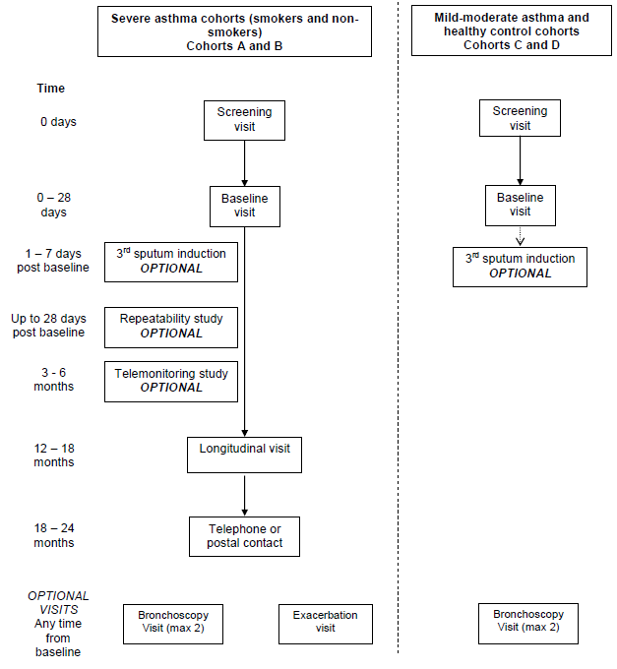
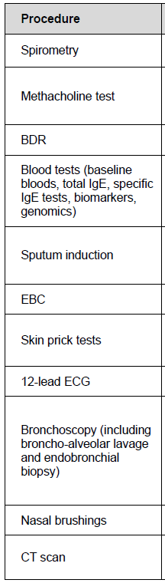
Study Visits and Procedures

Slide 8
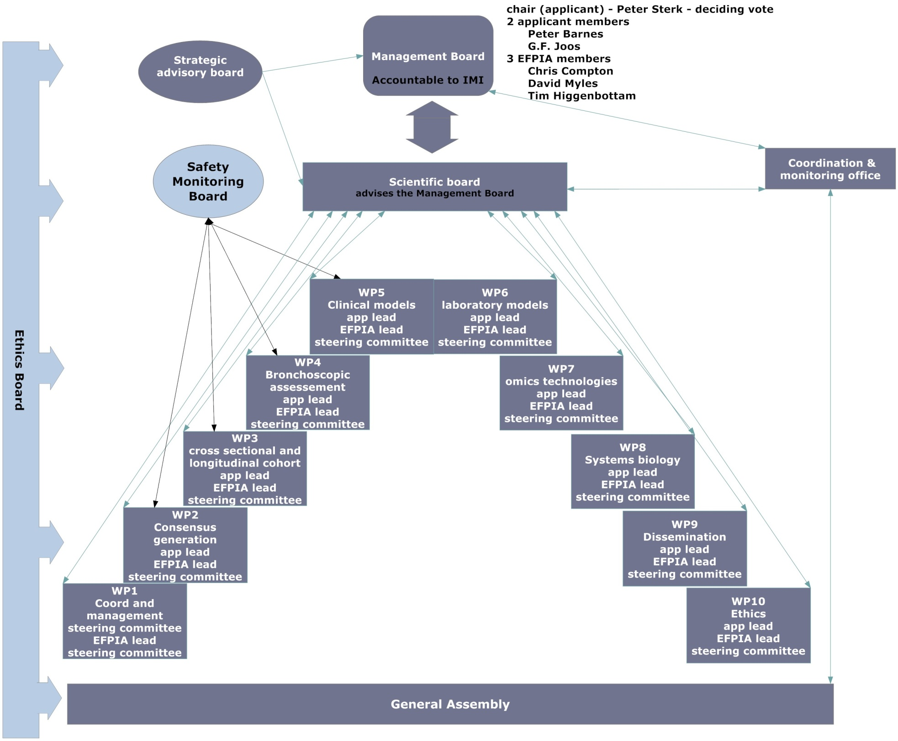

Slide 9
What Have We Achieved?
Recruitment completed April 2013
Follow up visits completed April 2014
Ongoing data analysis
First handprint June 2014!
Cooperation, collaboration and camaraderie!

Slide 10
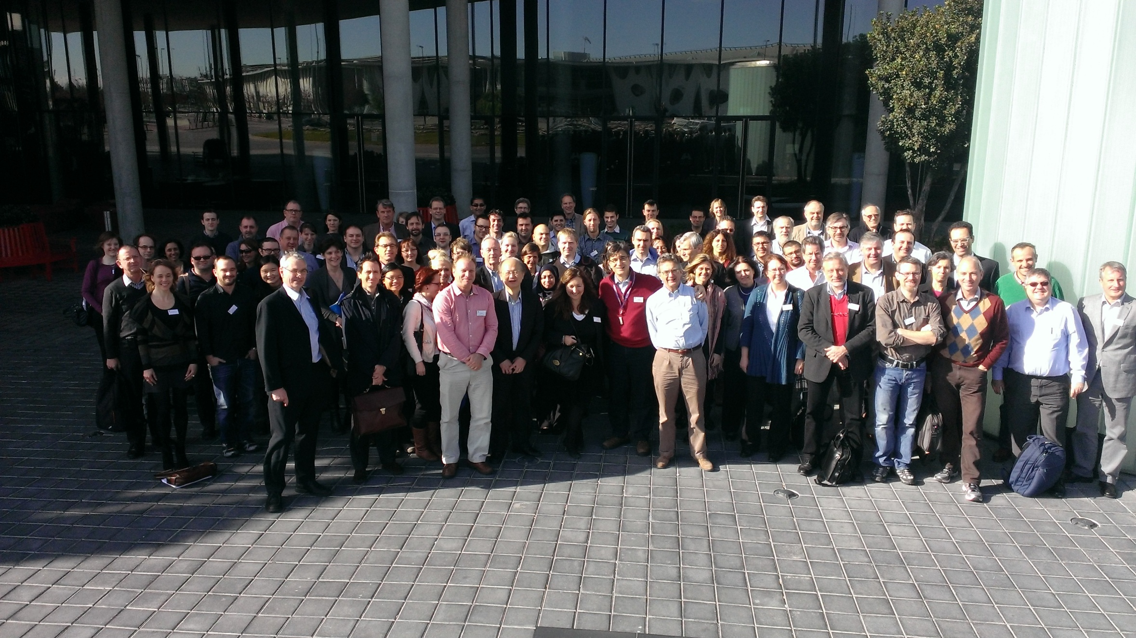
The U-BIOPRED FAMILY!

