Slide 1



Why buildings are key to achieve a better health in the EU?
Daniela Morghenti
Policy adviser
daniela.morghenti@efanet.org
danimorghenti

Slide 2

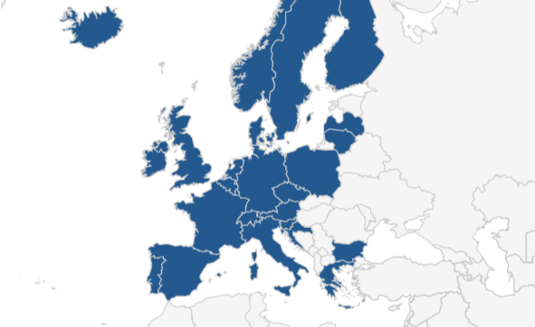

Who are we?
A European alliance of 41 allergy, asthma and chronic obstructive pulmonary disease (COPD) national patients’ associations
We represent 25 European countries
We represent the voices of ½ million patients in Europe
We are dedicated to making Europe a place where patients live in a safe enviroment

Slide 3
Why is indoor air quality a priority for patients?

Slide 4
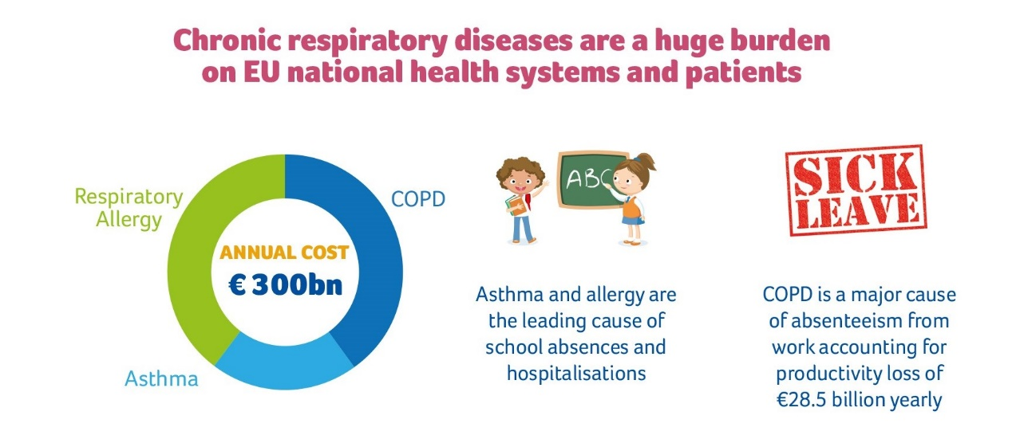
Indoor air quality needs to be addressed
Chronic respiratory diseases are amongst the most prevalent chronic diseases in Europe
… and our strategy is to engage!

Slide 5
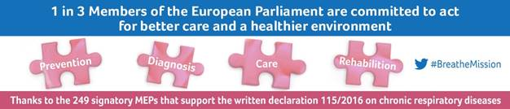
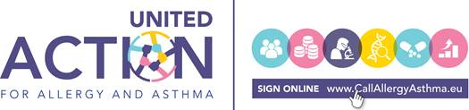
EFA position:
EU strategy on chronic respiratory diseases
Health in all policies principle is important but,
we should also include prevention in all policies

Slide 6
Prevention takes many forms:
tacking environmental determinants is one
“Air quality is one of the main identified problems of environmental pollution related to health problems such as respiratory diseases, asthma, and allergies”
DG Sante
900 compounds HARMFUL TO HEALTH have been detected in indoor air quality:
Anthropogenic pollutants - building materials, and outdoor pollutants (VOC, NO2, CO2 , PM5, PM10)
Allergens - molds, pollen, and biological contaminants
Sources: Opinion on Risks Assessment on IAQ, Scientific Committee on Health and Environmental Risks

Slide 7
Indoor pollution and human health effects
Doctor’s diagnosis:
Lung function reduction
Bronchial hyper responsiveness
Respiratory infections
COPD
Asthma and rhinitis
Asthma Pneumonitis
Chronic cough
Patient’s expertise:
Reduced cognitive abilities
Lower memory
Tiredness
Headaches
Feverishness
Stomach problems
Skin and eyes problems
Patients’ susceptibility matters!
Sources: European Federation of Allergy and Airways Diseases Patients’ Association

Slide 8
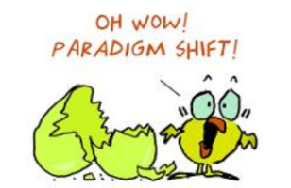

How do we solve the paradigm?
The relation between indoor air quality pollution and health effects is a complex paradigm to solve: it can’t either be properly quantified nor observed yet!
IAQ definition:
Indoor air quality is a complex exposure, and complex mixture of interactions
Patients problems:
A clinical test does not exist
A proper diagnosis does not exist
It is difficult to find a doctor familiar with indoor air quality illness related issues
Discrimination of patients in workplaces
How to address the issue?

Slide 9
Our testimonial: the case of Finland
“The Union of Health and Social Care Professionals in Finland reported issue related to IAQ, and 1/4 workers had suspicion of related illness occurring”
Source: University of Turku, Finland
“600.000 - 800.000 people in Finland are exposed to damaged environment every day”
Source: Ministry of the Environment, Finland
“Patients feel it is hard to find doctors who are familiar with their problems and medications – an medical bills pile up. Some lose their jobs or the ability to work, or leave in constant fear of what can happen”
Source: Organisation for Respiratory Health, Finland

Slide 10
Breathing is a prerequisite of life
Breathing clean indoor air quality is a vital priority for patients with chronic respiratory diseases, who have sensitive immune systems, and are particularly susceptible to infections, respiratory distress, and other problems associated with air contaminants
Indoor air quality is one of the most important environmental health problems
According to researchers lead by the Finish National Institute for Health and Welfare, asthma and allergy have been increasing in western industrialized countries since the 1960s, particularly among young people
Actions have to be taken with the purpose of reducing health risks in vulnerable people, and to contribute to reducing the development of disease

Slide 11
How can the energy performance of building Directive contribute to achieving better health in the EU?
respiratory

Slide 12




Preventing the disease before it begins or spreads!
An EU indoor air quality performance certificate could:
Prevent chronic respiratory diseases
Reduce cause of death and premature deaths
Guarantee the right to clean air in indoor spaces
Decrease discrimination

Slide 13
Why we should believe, act, and care?
An indoor air quality performance certificate is important for ALL of us
Prevention reduces costs in the national health system and improves people’s health and quality of life
Health is a fundamental right, and breathing clean air is a matter of public health and social justice
EU is committed to the WHO action plan for the prevention and control of non-communicable diseases promoting clean air and reducing premature deaths from chronic respiratory diseases by 25% by 2025
The opportunity to change is NOW!

Slide 14
Appendix, testimonies
Paediatrician Tiina Tuomela on Children’s Symptoms from Poor Indoor Air Quality
The Story of Heikki Huotari, who Fell Ill Due to Poor Indoor Air Quality
Santra and Pihla’s Story (part I)
Santra and Pihla’s Story (part II)

Slide 15
Thank you!

